Slide 1

Apollo + Graphql + React

Slide 2
1. Rest Api의 문제점

Slide 3
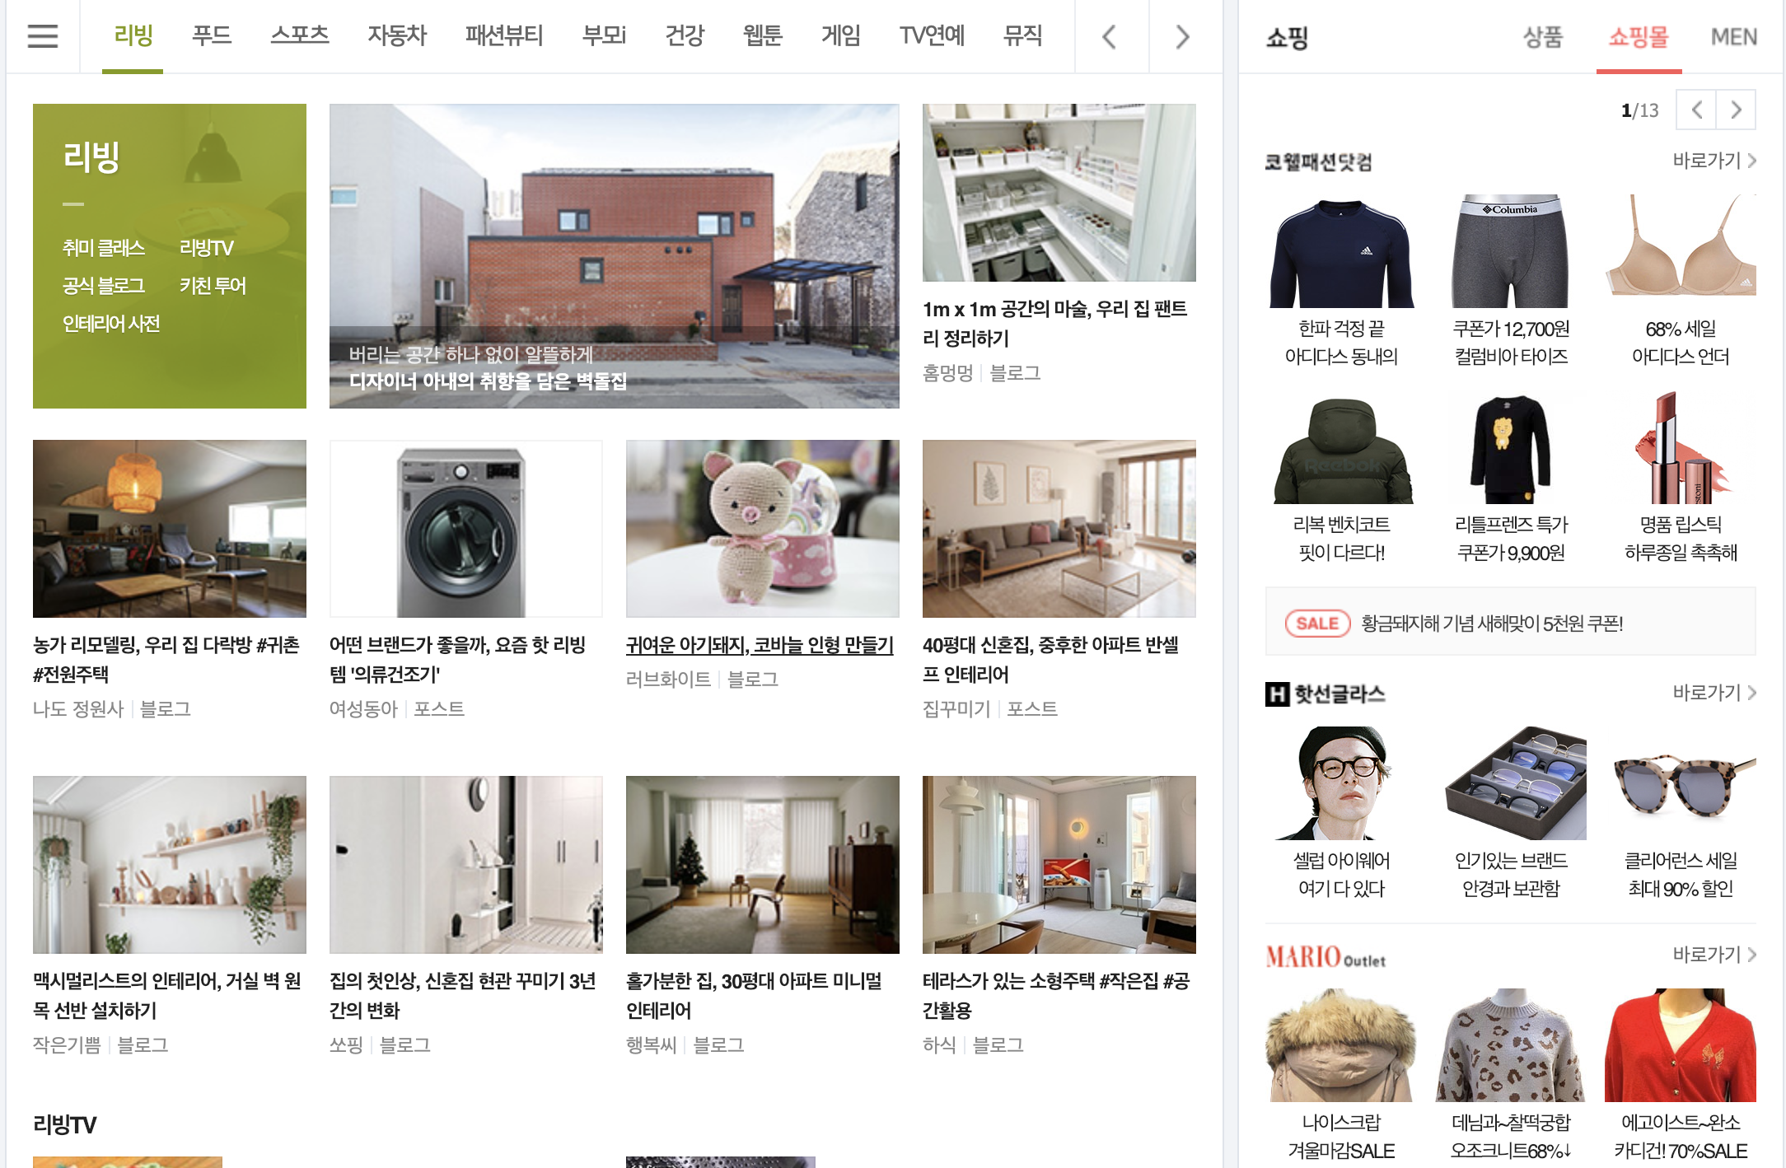
1. 너무 많은 EndPoint
/living/20190108
/shopping/20190108
/shopping/shop?코랄패션 닷컴
.
.
.
.
1.

Slide 4
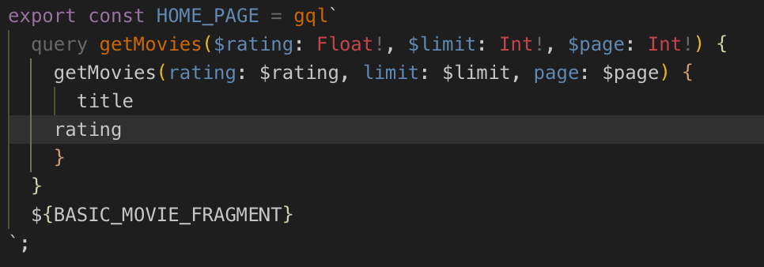
2. Over Fetching
/getMovies/?id=7934
return {
id,
name,
story,
actor
}
필요한 데이터만 가져올 수 있습니다.
2.

Slide 5
2. 실습

Slide 6
참고자료
1. Babel setting
https://hoony-gunputer.tistory.com/157
2. Apollo Setting
https://github.com/apollographql/react-apollo

